Slide 1
The Holocaust
VR150 Presentation Xu Wenwen
2021 Oct.19
Notes:
Let us begin today's topic, the Holocaust. As we all know, this is quite heavy.

Slide 2
Terms
Sturmabteilung (SA), Schutzstaffel (SS) armed forces of Nazi party
Synagogue: The equivalent of church of Jews
Ghetto: A certain area in a city where Jews gather
Persecution: the systematic mistreatment of an individual or group by another individual or group
Anti-Semitism: anti-Jewish ideology.
Notes:
I would first introduce some terms to prevent confusion in the presentation. The SS and SA refer to Nazi armed force, synagogue refers to the equivalent of church for Jews, and ghetto refers to a certain area in a city where Jews gather. Persecution means the systematic mistreatment of an individual or group by another individual or group

Slide 3
Overview
The mass persecution and murder of European Jews of Nazi Germany from 1941 to 1945.
By the end of the war in 1945, the Germans and their allies and collaborators killed nearly two out of every three European Jews.
Notes:
The Holocaust, as a historic event, is described as the mass persecution and murder of European Jews of Nazi Germany from 1941 to 1945. It led to the death of six million Jews, about two thirds of all European Jewish population before 1933. Since the period from 1941 to 1945 is not really so much, my presentation will focus more on historic views than facts. I will first briefly describe the historic events before 1933 that are relevant to the Holocaust, introduce my opinion on how antisemitism gained the support of German people, then the outcome of the disaster.

Slide 4
Outline
The Historical Background
The Psychology
The Racial Policy Before 1938
The Final Solution

Slide 5
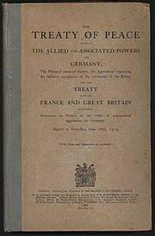

Treaty of Versailles (1919)
Destruction on German cultural confidence.
Notes:
y introduction on this topic will be begin from the end of World War I, which I think is where hatred towards German Jews began to emerge and thrive. There's the Treaty of Versailles, it has been introduced quite a few times by all the amazing previous presentations, so I will just quote a comment on a Youtube video: "Any British or French can go into the center of Berlin, get a random German and beat him up". I think this summarizes the treaty fair enough. The treaty, to the Germans is more than economic burden, it is a humiliation. The Germans did put great efforts into the war, had some of the worst sufferings, but everything left of the war is a humiliating peace treaty. A nation, once the most powerful and thriving in the whole world, became the most pitiful victim of war.

Slide 6
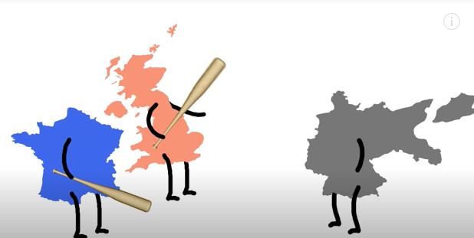
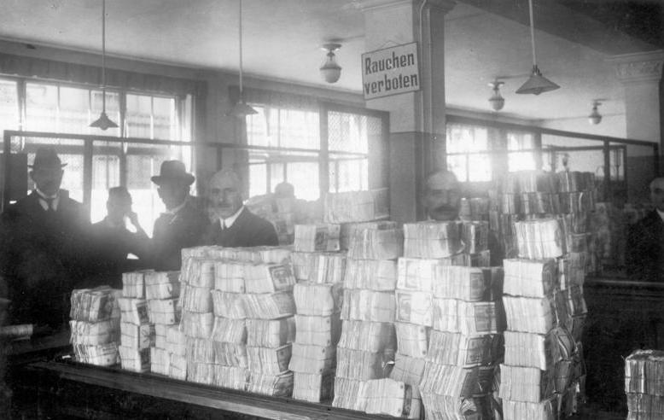
Hyperinflation (1923)
Destruction on German economy
Notes:
The failure in war is quickly followed by another disaster, the German Mark hyperinflation. It was caused by the Weimar Republic printing too much paper Mark to pay the Allies for reparation fees. It was a destruction to the economy of Germany.

Slide 7
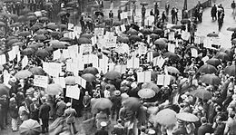
The Great Depression (1930)
Worldwide economic crisis
Notes:
After a short period of stability, Germany found itself in another crisis, the Great Depression. In the case of Germany at that time, with regret I will state my opinion, the democracy is causing the failure of the Weimar government. The Weimar Republic is indeed an advanced democratic government. However, in a nation where social, economical and diplomatic problems are emerging everywhere, there is need of a decisive government. A newborn democratic government, the Weimar Republic, is not mature enough to handle such severe crisis. When there are too many people voting for different opinions, it is hard to have a decisive conclusion of what to do. The Weimar Republic Constitution did not have a clear statement of how emergency situations can be handled. As a result, the emergency situation of hyperinflation messed up badly because of the incompetent government, while the right to announce emergency was abused later by the Nazis, which eventually led to the end of Weimar Republic.

Slide 8
crisis during Weimar republic
Treaty of Versailles (1919)
Hyperinflation (1923)
The Great Depression (1930)
All the unfortunate disasters turns into negative emotions in German people, waiting for ignition.
Notes:
Consider all those disasters, it remains a question for social scientists whether it should be interpreted as social or man-made crisis. However when the psychological factor kicks in, the question is no longer important. When all the people are having negative emotions on a group of people, thinking they are guilty, it doesn’t matter whether they are innocent or not.

Slide 9
Outline
The Historical Background
The Psychology
The Racial Policy Before 1938
The Final Solution
Notes:
Unfortunately, this part may contain some unpleasant facts on human psychology. At the time, the Nazis captured the darkest side of humanity to rise to power. Here I will introduce what the phenomenons are, and how Nazi propaganda utilized that for its own benefits. When I introduce the psychological phenomenon, I will try my best to compare the situation of ourselves, and the German people at that time. In some cases, I feel we share some psychologies with them.

Slide 10
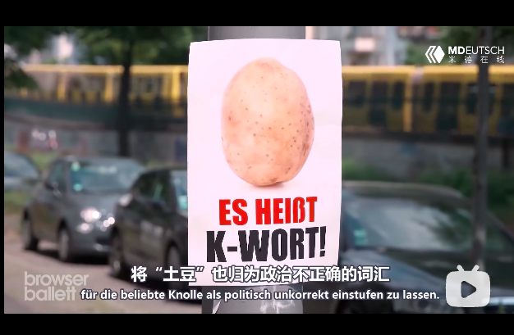
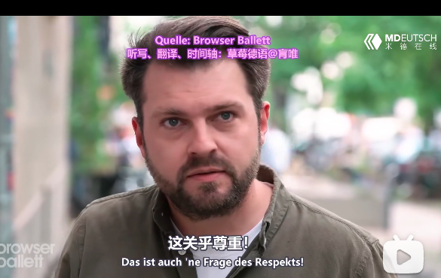
Stereotype
A generalized belief about a particular category of people. It is an expectation that people might have about every person of a particular group.
Notes:
Above all the psychological phenomenon I want to discuss, there is the stereotype phenomenon, it states that people tend to have generalize belief about a particular category of people, for example, Chinese people are hardworking and competitive, American people emphasize freedom, and so on. Here is a weird stereotype that says German people all look like potatoes. Back to our topic, the long-existing stereotype of Jews is that they are good at financing. Being good at financing can easily lead to another stereotype that they are rich, which in a time of crisis, will make many people jealous, and jealousy easily turn to hate. They be like, we are all suffering, why are you having all the money? The Nazi then did their propaganda on the basis of this certain emotion.

Slide 11
Jews stereotype conspiracy
Jews are disloyal cowards, responsible for the failure of war.
Jews started the war to bring Europe to ruins to make Europe susceptible to Jewish control.
Foreign and domestic Jews co-conspiracy to mislead the nation into "surrender" and permanent "enslavement."
Jews used constitutional democracy to weaken the political will of the nation.
Notes:
In this period, Nazi propaganda deliberately described the Jews as cowards, conspirators that are plotting to take over the control of the whole world. Here I quote some of the stereotypes I feel the most important. Jews are disloyal cowards, responsible for the failure of war. Before the war, Jews started the war to bring Europe to ruins to control Europe. During the war, foreign and domestic Jews co-conspiracy to mislead the nation into “surrender” and permanent “enslavement.“ After the war, Jews used constitutional democracy to weaken the political will of the nation. Just by reading these three sentences we can find it contradicts itself. How can such cowards plot such an evil scheme, and how can such scheme work so well for a disloyal group? Anyone can find the contradiction in the propaganda, how did the Nazis plant the ideology into the people? And this is the power of propaganda. As Hitler once said, the people are obedient and easy to control, especially when a talented speech maker like him is leading the way.

Slide 12
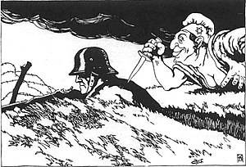
Nazi Psychological Propaganda strategy
1. Traitors or incompetent allies are more hated than enemies.
2. People that are different tend to get isolated.
3. Those who feel frustration may easily turn aggressive at others.
Notes:
This is where the psychology factor kick in. Firstly, traitors and incompetent allies are more hated than enemies. Some of us may have the experience of getting mad at teammates during teamwork. The teammate may be a free-rider during course work, the worst player in a basketball match, or some player who AFK during multiplayer video game. In the case of video games, I hear much more people yelling at teammates than at their opponents. I think that is the same with politics. When World War I goes wrong in Germany, Lots of the hatred towards Jews are basically the same as yelling at incompetent teammates during video games. In this case, the Nazis intentionally propagated them as disloyal cowards, responsible for the failure of war.
Secondly, different people tend to get isolated. Whether in kindergarten, school or workplace or in politics, those people that are different from others are more likely to get bullied. I have a vague memory of my kindergarten, on the receiving end of bullying is children who have distinct appearance, speak different accent, or have a weird name (like me). Unfortunately, the dark side of humanity lies even in the youngest children. Adolf Hitler himself got bullied in school very often, for being an Austrian. For the Jews in Germany, they have different lifestyles, appearances, and values. When faced with an event like the failure of World War I, even if the failure is due to quite a lot of social, military, diplomacy and economical reasons, people are still more likely to throw their anger at the Jews. They be like "Someone has to be blamed, why not blame the Jews". The Nazis then seized the opportunity to make the Jews the scapegoat(替罪羊).

Slide 13
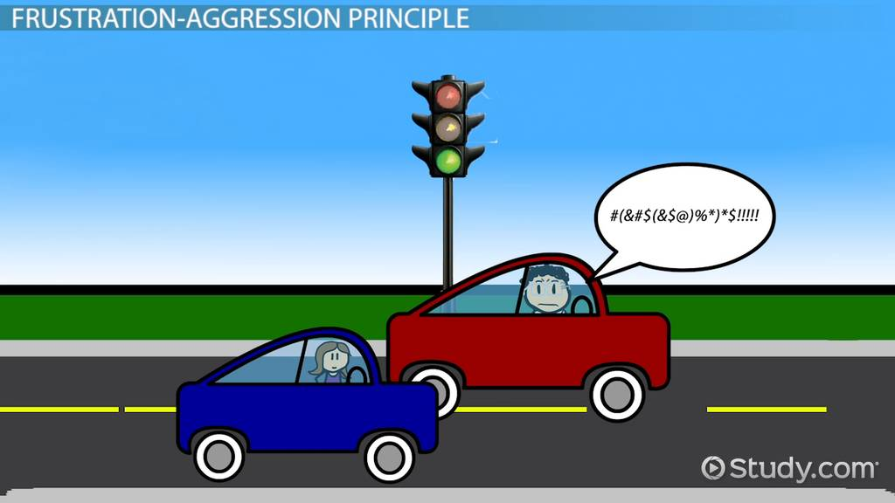
frustration–aggression–displacement theory
Aggression is the result of blocking, or frustrating, a person's efforts to attain a goal.
Nazi Germany utilized such psychology to gain public support, at the expense of all the Jews.
Notes:
Then, the most important psychology, called the frustration-aggression principle. It basically states that those who feel frustration may easily turn aggressive at others. That is kinda the same as us students. When we feel frustrated about something, some integrations that blocks our way for half an hour, some JOJ case that never passes, some random errors during computer engineering courses, the list goes on. When something like that happens, we are very likely to turn aggressive, and think badly of others. We sometimes think something like “Crap what’s wrong with this software? ” As the people are already distrusting the Jews, Nazis took it a step further, propagated the Jews conspiracy theory. It states that foreign Jews dominated the Versailles meeting, and their co-conspirators, the domestic Jews, signed the treaty to mislead the nation into "surrender" and permanent "enslavement". The nonsense conspiracy was believed by quite a lot of people at the time. And I believe this is the major reason that anti Jewish ideas eventually came out from under the shadows into broad daylight, and led to such horrible consequence. Here is a side note. When I was writing this part, I have a shocking feeling that we are not so far from the German people at that time, we even share some feelings in common. Therefore, I wish to bring these unpleasant psychologies out to you, let all of us be aware, let none be controlled or misled by negative emotions.

Slide 14
Nazi ideology
“German-blooded” people were “superior” to the other groups, while some groups were so “inferior” as to be “subhuman.”
“The Jews” made up a group that was not only “subhuman” but also “the most dangerous enemy of the German people.” Without these beliefs, the Nazis’ development of a program of genocide could not have happened.
Notes:
Back to the topic. Meanwhile, the Nazis decided to unite all the people other than the Jews, the “Aryan”, so-called German-blooded people. After the failure of World War II, By complementing the Aryans, more than ninety percent of German population, and discriminating the Jews, about one percent of German population, the Nazis successfully captured the interest of the majority of people, set up a team to work together with, and set up a scapegoat to be hated. By exploiting the dark side of humanity, the Nazis rose to power. This is another downside of the democracy, giving every person a vote is a fair but definitely not effective way to assure justice. The situation is that majority of people literally elected a government to persecute a minority of people. It harms the benefit of a small group to a large extent, and gives benefit to a large group to a small extent. To describe it more clearly, for example, in this class, I begin a vote, pick a random person that says, hey you, give everyone else one hundred RMB. Very likely everyone except the one agree to my proposal, right? The vote will be passed, but this is a very wrong thing, nothing different from plundering or robbery. Again, the newborn Weimar government is not competent enough to prevent such thing from happening. This is probably a common dilemma of all democratic governments.

Slide 15
Outline
The Historical Background
The Psychology
The Racial Policy Before 1938
The Final Solution
Notes:
Then here comes the introduction of the historical fact part.

Slide 16
Racial policies
April 1, 1933, the Nazi boycott of Jewish businesses was observed throughout Germany.
April 7, 1933, Jews were banned from government jobs. From then on, Jews were forced to work in more menial positions, becoming second-class citizens.
August 25, 1933, the Nazis signed the Haavara Agreement to allow German Jews to emigrate to Palestine in exchange for a portion of their economic assets
May 1935, Jews were forbidden to join the Wehrmacht (the armed forces), and in the summer of the same year, anti-semitic propaganda appeared in shops and restaurants.
September 15, 1935, the "Law for the Protection of German Blood and Honor"
Notes:
On April 1, 1933, the Nazi boycott of Jewish businesses was observed throughout Germany. Only six days later, the Law for the Restoration of the Professional Civil Service was passed, banning Jews from government jobs. This is the same year Hitler was appointed chancellor. By the way, here we see a severe consequence of Nazi rising to power, there is no clear distinction between the activity of government and of a party. The SA boycotting Jewish business can be recognized as a party action, but any Jewish resistance will obviously be suppressed by government forces. Hence, there is no clear responsibility difference between party and government, and those who get unfair treatment cannot find anyone responsible for the issue.

Slide 17
Racial policies
In 1936, Jews were banned from all professional jobs.
Between 1937 and 1938, new laws were implemented, and the segregation of Jews from the "German Aryan" population was completed.
From March 1, 1938, government contracts could not be awarded to Jewish businesses.
On September 30, "Aryan" doctors could only treat "Aryan" patients.
Provision of medical care to Jews was already hampered because Jews were banned from being doctors.
Notes:
In the following years, Jews were banned from certain jobs, officially claimed as inferiors, and deprived of multiple civilian rights. Jews were consequently expelled from German society. Here I emphasize the word "expel", since it will differ a lot from the events after 1938. As we see, Germany at this time is seeking to sign treaties to send Jews out of Germany for economic profits. However, everything changed radically after the event of the Kristallnacht.

Slide 18
The Kristallnacht (9 November 1938)
Expulsion of Polish Jews in Germany
Shooting of German diplomat Ernst vom Rath
The Sturmabteilung and the Schutzstaffel were ordered by Nazi leaders to riot against the Jews.
The windows of about 7,500 Jewish stores and businesses shattered. 267 synagogues destroyed. Over 1,400 synagogues and prayer rooms, many Jewish cemeteries, more than 7,000 Jewish shops, and 29 department stores damaged. More than 30,000 Jewish men arrested.
Notes:
The Kristallnacht began because of a political assassination. As the German government began to expel the Polish Jews to Poland, a Polish Jew living in France decided to assassinate the German ambassador in France as retaliation. As a result, the German diplomat Ernst vom Rath died of wounds. After hearing such news, the leaders of Nazi government ordered a riot against the Jews. The Sturmabteilung and Schutzstaffel shattered the windows of about 7,500 Jewish stores and businesses, and looted their goods. There were lots of Jews being beaten or assaulted. Lots of synagogues were destroyed, lots of Jewish family ransacked, and thirty thousand Jewish men arrested and sent to concentration camps.

Slide 19
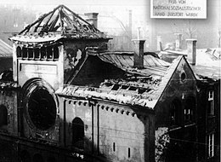
The Kristallnacht (9 November 1938)
Kristallnacht changed the nature of Nazi Germany's persecution of the Jews from economic, political, and social exclusion to physical violence, including beatings, incarceration, and murder.
Prior to this large-scale and organized violence against the Jews, the Nazi's primary objective was to eject them from Germany, leaving their wealth behind.
After this event, the Nazi's primary objective switched to physically destroy all Jewish existence.
Notes:
Again, the policy came from the government, and the violent actions came from the party. The government is for administrative persecution, while the party force is for upfront violence. Hitler and his followers did balance these power well, which granted him all the power that didn’t belong to him. This was the first time Nazi officials made massive arrests of Jews specifically because they were Jews, without any further cause for arrest. This is just the first time, there are much more to come in the following seven years, and not only in Germany, in the whole Europe. The form of persecution changed from expulsion to violence.

Slide 20
Outline
The Historical Background
The Psychology
The Racial Policy Before 1938
The Final Solution
Notes:
Now here is the most heavy part, the final solution. Where most of the violence and killing happen.

Slide 21
World war II and Wannsee conference
The "Final Solution" was the code name for the systematic, deliberate, physical annihilation of the European Jews. At some still undetermined time in 1941, Adolf Hitler authorized this European-wide scheme for mass murder.
Notes:
World War II eventually broke out in less than a year after the Kristallnacht. Nazi Germany quickly ran into a resource shortage. This made Nazi excuse for even more radical approach to destroy the Jews. Meanwhile, as the territory of Germany expanded, much more European Jews became victims of German Holocaust. The war quickly led to much violence in Germany, and occupied territories. Much more Jews were arrested and put into concentration camps in mass. They were planned to be wiped out by the Wannsee Conference in 1942. On January 20, 1942, 15 high-ranking Nazi Party and German government officials gathered in the Berlin suburb of Wannsee. They are to discuss about the “Final Solution”. Part of the reason for the dramatic rise in form of persecution is that Germany is short of resources, and setting up forced labor camps, limiting the resources Jews can have is a way to relieve the pressure of the frontline. Now, we see that as the Kristallnacht had already been ordered, there is simply no turning back. The Nazi would have to either wipe out every Jew they see or receive constant resistance from the Jews.
Here I introduce how Nazis planned and implemented the Holocaust. All persecuted Jews in the occupied territory of Germany are first forced to live in the ghettos, then transported to labor camps, and at last, extinction camps.

Slide 22
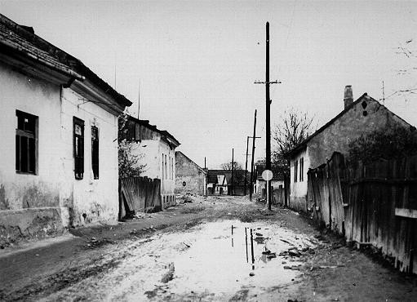
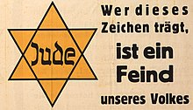
Ghettos
The creation of ghettos was a key step in the Nazi process of brutally separating, persecuting, and ultimately destroying Europe's Jews.
The largest ghetto in occupied Poland was the Warsaw ghetto. In Warsaw, more than 400,000 Jews were crowded into an area of 1.3 square miles.
Notes:
The creation of ghettos was a key step in the Nazi process of brutally separating, persecuting, and ultimately destroying Europe's Jews. Jews were forced to move into the ghettos, where living conditions were miserable. Ghettos were often enclosed districts that isolated Jews from the non-Jewish population and from other Jewish communities. The word ghetto originally means a part of Venice where the Jewish population is high. In this case, ghettos are the places to segregate the Jews from others, and wait for further exploitation and murder. The ghettos are usually places of poor living condition. German occupation authorities established the first ghetto in occupied Poland in October 1939, while the largest ghetto in occupied Poland was the Warsaw ghetto. In Warsaw, more than 400,000 Jews were crowded into an area of 1.3 square miles. That is about 120,000 people per square kilometer. As a comparison, that of Shanghai is 3631 per square kilometers. It is really hard to imagine how life will be like in such a crowded and unsanitary place, where Nazi troops perform violence on residents every day. The ghettos are usually a temporary place to settle the Jews, some ghettos last less than two weeks, while some exist for a bit more than a year. They act as the transition stop towards concentration camps. There may be a Nazi officer announcing departure any time. When the time comes, all the Jews were forced to be (quote) "resettled to the east", which actually means being sent to concentration camps.

Slide 23
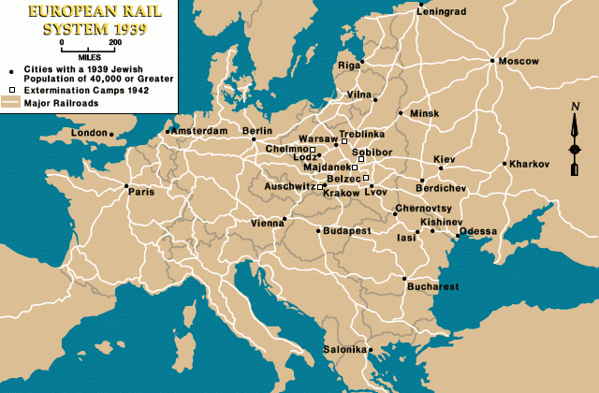
The final solution
After the Wannsee Conference, the Nazis decided to put the Final Solution into practice, to murder all European Jews.
Notes:
After the Wannsee Conference, the Nazis decided to put the Final Solution into practice, to murder all European Jews.

Slide 24
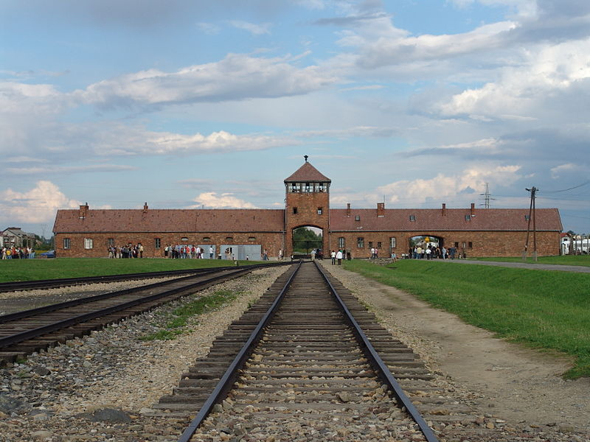
Concentration camps
Jews are efficiently exploited out of their remaining values, then killed by mass.
Poor living conditions
Bad sanitary environment
Overcrowded
Overworking
Notes:
Here I introduce one of the most evil constructions, the concentration camps. The whole arresting, transporting, exploiting and disposing of Jews can be described as a work of engineering, where Jews are efficiently exploited out of their remaining values. The European railway provided much convenience for mass transportation of Jews. All the Jews are taken to these rural areas where camps are built. The Jews are taken to forced-labor camps to work for military production, where they can have very limited nutrition and horrible sanitary conditions. When their physical conditions are no longer suitable for work, they get sent to killing centers, either to cruel human experiments or to gas chambers. There is a system of level of prisoners, determining which kind of prisoner should be sent to gas chamber, which should be human experimented on, which should "work to death". I will not go into detail of this since it causes some nasty feelings. The point is, the concentration camp is an industrialized killing chamber, Jews in the camp are expected average lifetime of three months under miserable conditions.
I have found some descriptions of the life in the concentration camps from survivors of Austerlitz-Birkenau Camp. The descriptions are astonishing.
Upon arrival, if an SS doctor pointed to one side, the person whose life was in question joined those who were fit for work. If he pointed to the other side, it meant immediate execution. Approximately 75-80% of people who were deported to Auschwitz were sent to the gas chambers in the first selection, as soon as they arrived.
The average life expectancy did not exceed a few weeks after imprisonment.
People were forced to work at a frenzied pace for more than 11 hours.
The rooms were so overcrowded that prisoners could sleep only on their sides, in three rows. Three-tiered bunks began appearing gradually in the rooms from February 1941. Theoretically designed for three prisoners, they in fact accommodated more.
In the first months, the prisoners drew water from two wells and relieved themselves in a provisional outdoor latrine. After the rebuilding of the camp, each building had lavatories, usually on the ground floor, containing 22 toilets, urinals, and washbasins with trough-type drains and 42 spigots installed above them.
The brick barracks stood in the oldest part of the camp, inside each of them were 60 brick partitions with three tiers, making a total of 180 sleeping places, each designed to accommodate 4 prisoners. The SS therefore envisioned a capacity of over 700 prisoners per block.
The daily ration usually consisted of a bowl of a bitter beverage for breakfast, a dish of thin soup made from rotten vegetables or meat at midday, and a crust of bread and a small portion of margarine before bed.
This basically means 700 people per room, and 20 toilets per building. All the rooms are badly furnitured and unsanitary. The food are basically rubbish, and excessive amount of labor. All the disturbing, shocking, but true historical facts.

Slide 25
Ordinary people during the holocaust
Nazi leaders received the active help of countless officials and ordinary people in Germany and the 17 other countries where the victims lived.
Reasons for the help of non-Germans included self-interest and involved political and personal calculations.
Most people stood by as Jews were rounded up to be shot or transported “to the East.” They witnessed the suffering of their neighbors.
Sometimes, they benefited, as they looted property and took over homes after the owners were gone.
Notes:
Now let us turn our eyes from the catastrophic camp to other non-Jewish people. What are they doing when all the Jewish are suffering? Sadly enough, before the war lots of people did nothing at the Nazi crimes, some even joined them in the persecution. As we have discussed in previous parts about people's psychology, people who regard themselves as Aryans either took in Nazi ideology, or just find it beneficial to knock out Jews from their own business. During the time of mass killing, lots of the German people didn't have much idea about what was going on in the concentration camp. This is the result of the industrial streamline of Holocaust, and the Nazi suppression of free press. Even more sadly, there are reported cases that Jews who survived the camps return to their hometown, only to find their houses stolen by their neighbors. There are also multiple cases that people assist the Gestapo, and the SS to round up Jews. The famous Anne Frank was a victim of such action. Unfortunately, it seems that during a period like the World War II, nothing can be really trusted.

Slide 26
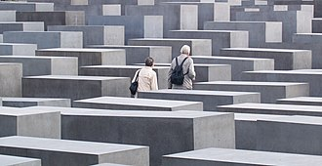
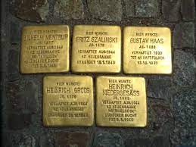
Aftermath
Two thirds of all European Jews were killed.
Notes:
The outcome of the Holocaust was horrendous. two thirds of all European Jews were killed. However, the United Nation did decide to found Israel, the nation for Jews. After living together with multiple ethnic groups and experiencing constant persecutions, the Jews had a home country at last. After the war, Germany asked lots of companies including Ford, Volkswagen to pay for the forced Jewish labor during war, and offered quite a lot of reparations fees to Jews in Germany and Israel. Memorials were built in Berlin, and Stolperstein were built in lots of Berlin roads. The Stolperstein is a road brick made out of metal, with the name of a Jewish victim of Holocaust carved on it. The Stolperstein can now be seen in lots of European cities, in memoir of all the Jews dying to the Holocaust. Again we should be reminded that such a horrible event is a lesson, that racist ideas can never lead to anywhere good.

Slide 27
References
https://en.wikipedia.org/wiki/The_Holocaust
https://encyclopedia.ushmm.org
https://mjhnyc.org
https://auschwitz.org
https://www.youtube.com/c/OverSimplified
Notes:
Here, I think the introduction of the heavy topic is over. There are much more horrible facts about the Holocaust, how the human experiment were done, how the transportation of Jews were done, how the Nazis punish the not obedient Jews, and so on. However, my point of view is, however horrible the consequence of Holocaust is, it is the result of decades of negative emotions hidden among the German people. When the Nazis came in, they ignited all the negative emotions for their benefits. When the negative emotions were broken loose, it cannot be stopped. When the violence begins, especially a nationwide violence activity, nothing can stop it. And all the following horrible events can just be predicted. This is also why I spent a large section of the presentation on the psychology of the German people at the time, and a bit less about the depressing life in ghettos and camps. In my opinion, to avoid being controlled by negative stereotypes and emotions is the key to prevent such disaster from happening again.

